Slide 1
Console I/O

Slide 2
Keyboard & Screen I/O in C++
It is perfectly valid to use the same I/O statements in C++ as in C : The very same printf, scanf, and other stdio.h functions that have been used until now.
However, C++ provides an alternative with the new stream input/output features for two reasons:
I/O methods in C++ support the concept of oop
I/O methods in C cannot handle the user-defined data types
Notes:
Instructor notes:
We now begin the migration from I/O in C to I/O in C++. A reminder that because C++ is a superset of C, all of the I/O functions that we have been using, such as printf and scanf which are found in the stdio.h header file, are still valid in C++.
C++ does provide alternative means of performing I/O on streams using the iostream header file. To take advantage of these stream I/O features we will need to include the iostream header file as described on this slide. To be completely ANSI compliant, we should also indicate that we are using the standard namespace “std” by including using namespace std; A namespace is a way of dividing the global space into subsections so that there are not conflicts with variables of the same name. Obviously this would be more of a problem on a very large project with many people writing software. All of the standard functions have been set up inside of the namespace “std”. If we do not declare that we are using the std namespace, then technically when we use any of the functions, such as cout and cin, we should prefix them with std:: to indicate that they come from the standard namespace. By indicating that we are using the standard namespace, we can use these functions without the prefix. Many compilers will allow us to get away with using the non-prefixed functions without having declared that we are using the standard namespace, but in a strictly ANSI compliant sense, we should indicate that we are using the standard namespace.

Slide 3
C++ Streams
Stream
A transfer of information in the form of a sequence of bytes
A stream is actually an object that is created before use and deleted after use. The data input/output operation is to extract data from the stream or add data to the stream.
Input stream
Input
device
Program
Output stream
Output
device

Slide 4
C++ Stream Classes
ios
istream
streambuf
ostream
iostream
istream_withassign
iostream_withassign
ostream_withassign

Slide 5
Pre-defined Streams
C++ contains several pre-defined streams that are automatically opened when a program begins its execution.
cin istream_withassign standard input device
cout ostream_withassign standard output device
cerr ostream_withassign standard error output device
clog ostream_withassign standard error output device
keyboard, can be redirected
screen, can be redirected
screen, can not be redirected
screen, can not be redirected

Slide 6
Using the header file iostream
Include <iostream> instead of “stdio.h”
Standard iostream objects:
cout - object providing a connection to the monitor
cin - object providing a connection to the keyboard
cerr - object providing a connection to error stream
To perform console input and output we send messages to one of these objects

Slide 7
The Extraction Operator (>>)
To get input from the keyboard we use the extraction operator and the object cin
Format: cin >> Variable;
The compiler figures out the type of the variable and reads in the appropriate type
cin ignores whitespaces (spaces, tabs, newlines)
Returns zero (false) when EOF is encountered, otherwise returns reference to the object from which it was invoked (i.e. cin)
while(cin) {
…
}

Slide 8

主观题
10分
#include <iostream>
using namespace std;
void main()
{ char ch;
cin>>ch;
while(ch != ‘\n’)
{ cout<<ch;
cin>>ch; }
}
With the input: ”I am a teacher \n”, what is the output?
正常使用主观题需2.0以上版本雨课堂
作答

Slide 9
Problem with using cin to input data
When using cin to input string data, if the string contains spaces, it cannot be fully input because when it encounters a space character, cin considers the string to be over.
To input white spaces, use istream member functions: get and getline.
class istream : virtual public ios {
public:
istream& operator>>(double &);
//overloaded many >> functions
int get(); //char c=cin.get();
istream& get(char &); //char c; cin.get(c);
istream& get(char *,int,char ='\n’); //char c[10]; cin.get(c, 9, ’$’);
istream& getline( char *,int,char ='\n');
istream& read(char *,int);
istream& ignore(int =1,int =EOF);
int peek();
istream& putback(char);
......
};

Slide 10
get Member Function
#include "iostream.h"
void main()
{ char ch;
cin.get(ch); //or ch=cin.get();
while(ch != ‘\n’)
{ cout<<ch;
cin.get(ch);
}
}
cin.get(): inputs a character from stream (even white spaces) and returns it
char c=cin.get();
cin.get( c ): inputs a character from stream and assigns it to c
char c;
cin.get(c);
Note: the difference between cin.get(ch); and cin>>ch;

Slide 11
“get” and “getline” Member Functions
cin.get(array, size, delimiter):
Accepts 3 arguments: array of characters, the size limit, and a delimiter ( default of ‘\n’).
Input a sequence of characters from stream till the delimiter or EOF is encountered or size-1 characters are read.
Uses the array as a buffer
When the delimiter is encountered, it remains in the input stream
Null character (‘\0’) is inserted into the array at the end of the characters
Unless delimiter flushed from stream, it will stay there
cin.getline(array, size, delimiter)
Operates like cin.get(buffer, size) but it discards the delimiter from the stream and does not store it in array
Null character inserted into array

Slide 12
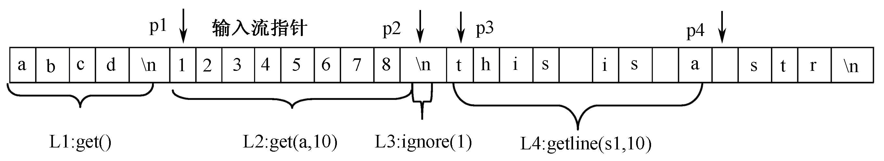
Example:
#include <iostream>
using namespace std;
void main(){
char c, a[50], s1[100];
cout<<"use get() input char: ";
while((c=cin.get())!='\n') //L1
cout<<c;
cout<<endl;
cout<<"use get(a,10) input char: ";
cin.get(a,10); //L2
cout<<a<<endl;
cin.ignore(1); //L3
cout<<"use getline(s1,10) input char: ";
cin.getline(s1,10); //L4
cout<<s1<<endl;
}
input from keyboard: abcd’\n’12345678’\n’this is a str’\n’

Slide 13
Difference between “get” and “getline”
Getline reads the delimiter symbol and discarded, and GET leaves the delimiter symbol in the stream.
Getline causes a CIN error when entering ultra-length (more than Len-1 characters), and Get does not cause.

Slide 14
主观题
10分
#include "iostream.h"
void main()
{char ch[10];
int a=6;
cin.get(ch,a,'\\');
cout<<ch<<endl;
cin.get(ch,a,'\\');
cout<<ch<<endl;
}
#include "iostream.h"
void main()
{char ch[10];
int a=6;
cin.getline(ch,a,'\\');
cout<<ch<<endl;
cin.getline(ch,a,'\\');
cout<<ch<<endl;
}
Suppose the string input from the keyboard is “abcd\efgh\”,
what is the output respectively?
作答

Slide 15
Output
To send output to the screen we use the insertion operator on the object cout cout << Expression;
The compiler figures out the type of the object and prints it out appropriately
Use mamber functions define in ostream:
class _CRTIMP ostream : virtual public ios {
public:
ostream& operator<<(…);
ostream& flush();
ostream& operator<<(long);
ostream& put(char);
ostream& write(const char *,int);
ostream& seekp(streampos);
......
};

Slide 16
“put” and “write” Member Functions
cout.put(char)
Outputs one character to specified stream
cout.put( 'A');
Returns a reference to the object that called it, so may be cascaded
cout.put( 'A' ).put( '\n' );
May be called with an ASCII-valued expression
cout.put( 65 );
Outputs A
cout.write(line, size)
Outputs the entire line till size characters are displayed
the functions will not terminate at a newline character
the functions will not terminate at a null character

Slide 17
Formatted Console I/O Operations
ios class member functions and flags
Manipulators
User-defined output functions

Slide 18
ios class functions and flags
ios class constains a large number of member functions to format the output
width() : specify the required field size
precision(): specify the number of digits to be displayed after the decimal point
fill(): specify a character that is used to fill the unused portion of field
setf(): specify format flags
unsetf(): clear the flags specified

Slide 19
Setting the Width
You can use the width(int) function to set the width for printing a value, but it only works for the next output command
int x = 42;
cout.width(5);
cout << x << ‘\n’;
cout << x << ‘\n’;
Output:
̺ ̺ ̺ 42
42

Slide 20
Setting the Fill Character
Use the fill(char) function to set the fill character. The character remains as the fill character until set again.
int x = 42;
cout.width(5);
cout.fill(‘*’);
cout << x << ‘\n’;
Output:
***42

Slide 21
Setting Precision
By default, the floating numbers are printed with six digits
Use the precision(int) function to specify the number of digits to be displayed
The setting stays in effect until it is reset

Slide 22
cout.precision(3);
cout<<sqrt(2)<<“\n”;
cout<<3.14159<<“\n”;
cout<<2.50003<<“\n”;
cout<<1234.56<<“\n”;
cout.precision(2);
cout.width(5);
cout.fill(‘*’)
cout<<1.2345;

Slide 23
Flags
IOS defined a word (16 bits) to control I/O format
Each bit represent one format
First bit (skip input white spaces)
Second bit (left adjusted)
Third bit (right adjusted)
0
0
0
0
0
0
0
0
0
0
0
0
0
0
0
1
0
0
0
0
0
0
0
0
0
0
0
0
0
0
1
0
0
0
0
0
0
0
0
0
0
0
0
0
0
1
0
0

Slide 24
value meaning I/O
0X0001 skip white spaces I
0X0002 left adjustfied O
0X0004 right adjustfied O
0X0008 internal adjustfied O
0X0010 decimal base I/O
0X0020 octal base I/O
0X0040 hexadecimal base I/O
0X0080 show the base of an output number O
0X0100 show point O
0X0400 show positive O
0X0800 scientific O
0X1000 fixed O

Slide 25
In class ios, a set of enumeration constants are defined to represent the values of the flag word
Ios::skipws 0X0001 skip input white spaces
Ios::left 0X0002 left adjustified
Ios::right 0X0004 right adjustified
Ios:: internal 0X0008 internal adjustified
Ios:: dec 0X0010 decimal base
Ios:: oct 0X0020 octal base
Ios:: hex 0X0040 hexadecimal base
Ios:: showbase 0X0080 show the base of an output number
Ios:: showpoint 0X0100 show a decimal point and trailing zeros
Ios:: uppercase 0X0200
Ios:: showpos 0X0400 a plus sign is output before positive integer values
Ios:: scientific 0X0800 floating-point numbers are written in e-notation
Ios: fixed 0X1000 floating-point numbers are not written in e-notation
ios:: unitbuf 0X2000 输出操作后立即刷新流
Ios:: stdio 0X4000 输出操作后刷新stdout 和 stdree
Adjust field
Base field
float field

Slide 26
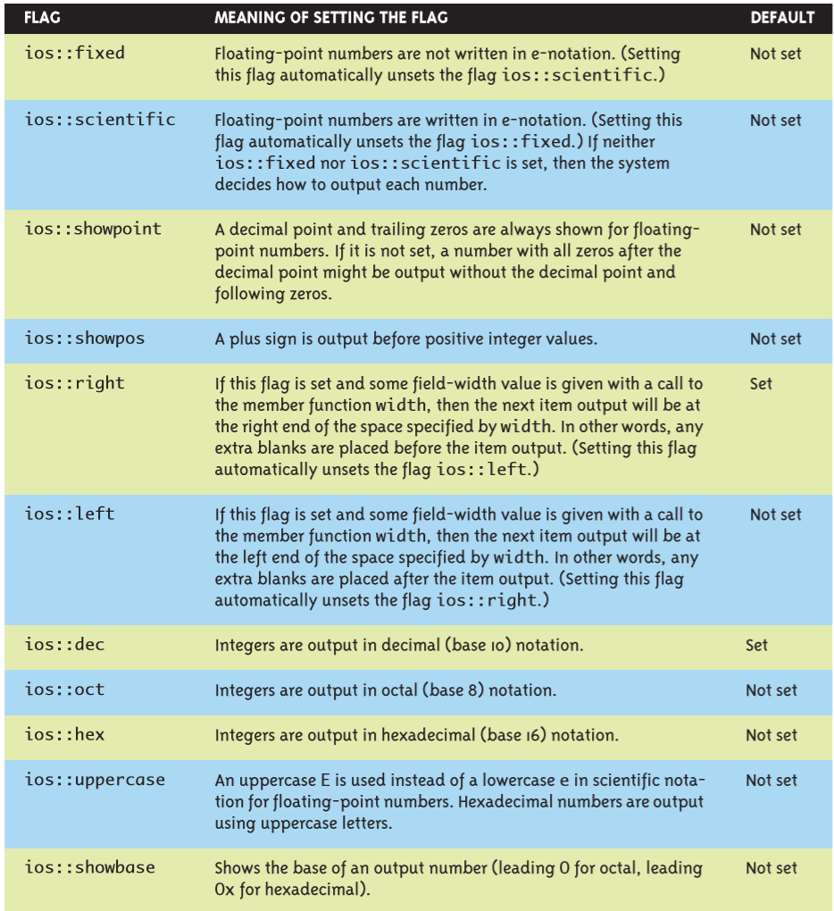

Slide 27
Format required | Flag | Bit-field
Left_justified output | ios::left | ios::adjustfield
Right_justified output | ios::right | ios::adjustfield
Padding after sign or base | ios:: internal | ios::adjustfield
Scientific notation | ios::scientific | ios::floatfield
Fixed point notation | ios::fixed | ios::floatfield
Decimal base | ios::dec | ios::basefield
Octal base | ios::oct | ios::basefield
Hexadecimal base | ios::hex | ios::basefield

Slide 28
Setting Format Flags
The object cout has flags that determine how objects are printed. To change how things are printed we access and change these flags
To set a flag(s) we use the setf function
cout.setf(0X0001); / cout.unsetf(0X0001);
cout.setf(ios::skipws);
Set more than one bits simutaniously
cout.setf(0X0001|0X0002);
cout.setf(ios::skipws|ios::left);
But in order to be able to set flags we often have to unset other flags first, to do so we use the unsetf function:
cout.unsetf(ios::dec | ios::oct | ios::hex);
cout.unsetf(ios::basefield);

Slide 29
Setting Format Flags (cont)
C++ also provides a short-hand to combine both operations:
cout.setf(OnFlags, OffFlags)
First turns off the flags OffFlags
Then turns on the flags OnFlags
cout.setf(ios::oct, ios::dec | ios::oct | ios::hex);
相当于：
cout.unsetf(ios::dec | ios::oct | ios::hex)；
cout.setf(ios::oct);

Slide 30
Integer Base and Format Flags
Choosing the base to print out an integer in:
Flags to use:
ios::dec - show ints as decimal (the default)
ios::oct - show ints as octal
ios::hex - show ints as hexadecimal

Slide 31
Integer Base Example
int x = 42;
cout.setf(ios::oct, ios::basefield);
cout << x << '\n';
// Outputs 52\n
cout.setf(ios::hex, ios::basefield);
cout << x << '\n';
// Outputs 2a\n
cout.setf(ios::dec|ios::showpos, ios::basefield);
cout << x << '\n';
// Outputs 42\n

Slide 32
Justification
Set justification using flags ios::left, ios::right, and ios::internal (after sign or base) - only one
Use ios::adjustfield to turn all three flags off
int x = -42;
cout.fill('*');
cout.setf(ios::right, ios::adjustfield);
cout.width(6);
cout << x << '\n';
cout.setf(ios::left, ios::adjustfield);
cout.width(6);
cout << x << '\n';
cout.setf(ios::internal, ios::adjustfield);
cout.width(6);
cout << x << '\n';

Slide 33
Floating Point Format
Can use flags ios::scientific and ios::fixed to force floating point output in scientific or fixed format
Only one flag at a time, ios::floatfield to turn off
cout.setf(ios::scientific,ios::floatfield);
cout << 123.45 << ‘\n’; // Outputs 1.2345e+02
cout.setf(ios::fixed,ios::floatfield);
cout << 5.67E1 << ‘\n’; // Outputs 56.7

Slide 34
Significant Digits in Float
Use function precision(int) to set the number of significant digits printed (may convert from fixed to scientific to print)
Effect of precision depends on format
scientific (total significant digits)
fixed (how many digits after decimal point)
float y = 23.1415;
cout.precision(1);
cout << y << '\n';
// Outputs 2e+01
cout.precision(2);
cout << y << '\n';
// Outputs 23
cout.precision(3);
cout << y << '\n';
// Outputs 23.1
cout.setf(ios::fixed,ios::floatfield);
cout.precision(1);
cout << y << '\n';
// Outputs 23.1
cout.precision(2);
cout << y << '\n';
// Outputs 23.14
cout.precision(3);
cout << y << '\n';
// Outputs 23.142

Slide 35
Showing the Base
The flag ios::showbase can be set (its default is off), it results in integers being printed in a way that demonstrates their base
decimal - no change
octal - leading 0
hexadecimal - leading 0x
int x = 42;
cout.setf(ios::showbase);
cout.setf(ios::oct,ios::basefield);
cout << x << '\n'; // Outputs 052\n
cout.setf(ios::hex,ios::basefield);
cout << x << '\n'; // Outputs 0x2a\n
cout.setf(ios::dec,ios::basefield);
cout << x << '\n'; // Outputs 42\n

Slide 36
Showing the Plus Sign
The flag ios::showpos can be set (its default is off) to print a + sign when a positive integer or floating point value is printed
int x = 42;
int y = 3.1415;
cout.setf(ios::showpos);
cout << x << '\n'; // Outputs +42\n
cout << y << ‘\n’; // Outputs +3.1415\n

Slide 37
Decimal Points in Floats
Set flag ios::showpoint to make sure decimal point appears in output, make up 0’s at the decimal point when the valid number is insufficient
float y = 3.0;
cout << y << ‘\n’;
// Outputs 3
cout.setf(ios::showpoint);
cout << y << ‘\n’;
// Outputs 3.00000

Slide 38
Showing Upper Case Hex Ints
The flag ios::uppercase (default off) can be used to indicate that the letters making up hexadecimal numbers should be shown as upper case:
int x = 42;
cout.setf(ios::uppercase);
cout.setf(ios::hex,ios::basefield);
cout << x << '\n'; // Outputs 2A\n

Slide 39
Displaying bools
Variables of type bool print out as 0 (false) or 1 (true)
To print out words (false, true) use flag ios::boolalpha
bool b = true;
cout.setf(ios::boolalpha);
cout << b << ‘\n’; // Outputs true
cout << (!b) << ‘\n’; // Outputs false

Slide 40
主观题
10分
写出下面程序的输出
#include<iostream>
using namespace std;
void main(){
char c[30]="this is string";
double d=-1234.8976;
cout.width(30);
cout.fill('*');
cout.setf(ios::left);
cout<<c<<"----L1"<<endl;
cout.width(30);
cout.setf(ios::right);
cout<<c<<"----L2"<<endl;
cout.setf(ios::dec|ios::showbase|ios::showpoint);
cout.width(30);
cout<<d<<"----L3"<<"\n";
cout.setf(ios::showpoint);
cout.precision(10);
cout.width(30);
cout<<d<<"----L4"<<"\n";
cout.width(30);
cout.setf(ios::oct,ios::basefield);
cout<<100<<"----L5"<<"\n";
}
作答

Slide 41
IOS member functions
width()
fill()
precision()
setf()
unsetf()

Slide 42
Manipulators
A manipulator is a simple function that can be included in an insertion or extraction chain
cout<<manip1<<manip2<<manip3<<item;
cout<<manip1<<item1<<manip2<<item2;
C++ manipulators
some are defined in the header file iomanip, must include <iomanip> to use
several are provided by stream classes
you can also create your own manipulators

Slide 43
Manipulators defined in <iomanip>
Manipulators taking 1 argument:
setw(int) - sets the width to int value
setfill(char) - sets fill char to char value
setprecision(int) - sets precision to int value
setbase(int) - sets int output to hex if int is 16, oct if int is 8,
dec if int is 0 or 10
setiosflags(flags) - set flags on
resetiosflags(flags) - sets flags off
Member funcitons:
width()
fill()
precision()
setf()
unsetf()
cout<<setfill(‘*’)<<setw(6)<<10<<setw(6)<<11<<setw(6)<<12<<endl;

Slide 44
Member funcions Manipulators
precision(n) setprecision(n)
width(n) setw(n)
fill(c) setfill(c)
setf() setiosflags()
unsetf() resetiosflags()

Slide 45
主观题
答案解析
10分
答案解析
What is the output of the following program segment:
float i=34.267, j=12.345;
cout << resetiosflags(ios::floatfield) << setiosflags(ios::fixed | ios::showpoint) << setw(7) << setprecision(2) << setfill(‘*’) <<i<<j << endl;
// outputs: **34.2712.35 // setw only valid for the next extraction operator
正常使用主观题需2.0以上版本雨课堂
作答
可为此题添加文本、图片、公式等解析，且需将内容全部放在本区域内。正常使用需3.0以上版本

Slide 46
主观题
答案解析
10分
答案解析
Write down the output of the following program segment, and rewrite the it with manipulators to realize the same formatted output:
char *pt=“China”;
cout.fill(‘*’);
cout.width(10);
cout<<pt<<endl;
char *pt=“China”; cout<<setfill(‘*’)<<setw(10)<<pt <<endl;
正常使用主观题需2.0以上版本雨课堂
作答
可为此题添加文本、图片、公式等解析，且需将内容全部放在本区域内。正常使用需3.0以上版本

Slide 47
Manipulators provided by stream classes
showbase（noshowbase） Display (or not display) the radix prefix of a number
cout<<setfill(‘*’)<<setw(10)<<hex<<showbase<<10<<endl;
showpoint（noshowpoint） Display decimal point (only when there is a decimal part)
cout<<showpoint<<3.0<<endl;
showpos（noshowpos） Display (not display) ‘+’ in non-negative numbers
uppercase(nouppercase)
cout<<setfill(‘*’)<<setw(10)<<hex<<showbase<<uppercase<<10<<endl;
dec /oct / hex
left/right left/right adjusted
cout<<setfill(‘*’)<<setw(10)<<hex<<showbase<<uppercase<<left<<10<<endl;
fixed Display floating point numbers as decimals
scientitific Display floating point numbers in scientific notation
flush Flush the output buffer
endl

Slide 48
主观题
10分
改写下面程序， 用操纵符格式化输出数据，实现同样的功能
#include<iostream>
using namespace std;
void main(){
char c[30]="this is string";
double d=-1234.8976;
cout.width(30);
cout.fill('*');
cout.setf(ios::left);
cout<<c<<"----L1"<<endl;
cout.width(30);
cout.setf(ios::right);
cout<<c<<"----L2"<<endl;
cout.setf(ios::dec|ios::showbase|ios::showpoint);
cout.width(30);
cout<<d<<"----L3"<<"\n";
cout.setf(ios::showpoint);
cout.precision(10);
cout.width(30);
cout<<d<<"----L4"<<"\n";
cout.width(30);
cout.setf(ios::oct,ios::basefield);
cout<<100<<"----L5"<<"\n";
}
作答

Slide 49
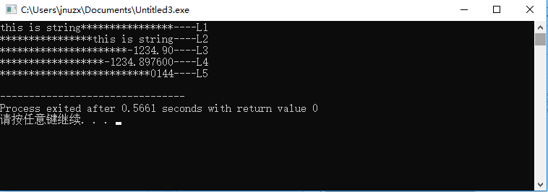
【例9-5】 修改例9-4，用操纵符格式化输出数据，实现同样的功能。
#include<iostream>
#include<iomanip>
using namespace std;
void main(){
char c[30]="this is string";
double d=-1234.8976;
cout<<setw(30)<<left<<setfill('*')<<c<<"----L1"<<endl;
cout<<setw(30)<<right<<c<<"----L2"<<endl;
cout<<setw(30)<<dec<<showbase<<showpoint<<d<<"----L3"<<"\n";
cout<<setw(30)<<showpoint<<setprecision(10)<<d<<"----L4"<<"\n";
cout<<setw(30)<<setbase(8)<<100<<"----L5"<<"\n";
}

Slide 50
Users can define their own manipulators by using:
ostream & manip_name(ostream &stream)
{
//your code
return stream;
}
EXAMPLE:
#include < iostream.h>
ostream & money(ostream & output)
{
return output<<“\t$”;
}
void main()
{
float owed=1.35, earned=23.1;
cout<<money<<owed<<money<<earned;
}
Output is:
$1.35 $23.1

Slide 51
#include<iostream>
#include<iomanip>
ostream & steup(ostream & stream)
{
stream.setf(ios::left);
stream<<setw(10)<<setfill(‘$’);
return stream;
}
void main()
{
cout<<10<<“ ”<<setup<<10<<setup;
}

